Slide 1



Data Storytelling with Power BI
Notes:
Happy morning guys. I am Dinesh Kumar. Product Manager at Syncfusion Software in Data Platform team. I am very happy to present this session as online webinar to all of you. Here we go!

Slide 2
To be a good learner, what is the most important SKILL required?
Notes:
We all know that learning is an essential skill that everyone needs. But to be a good learner, what is the most important life skill required?

Slide 3
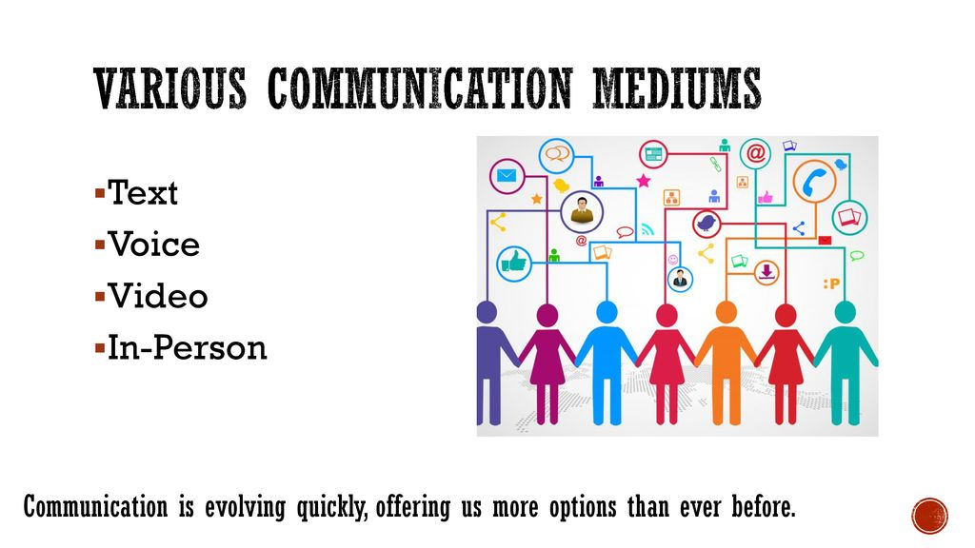
COMMUNICATION
Notes:
It is communication. Simply say transferring information to produce a greater understanding. Communication generally happens as non-verbal, vocal, written or visual via different mediums as you see in the slide.
Overall we should understand that communication is an essential soft skill for a successful career.

Slide 4
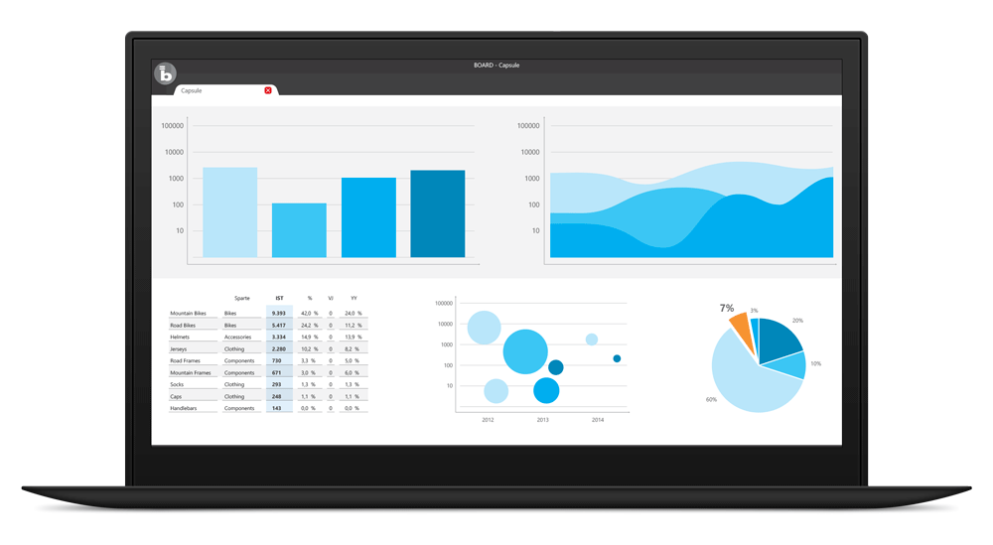
Visualize
BI tools for business decisions,
Microsoft Power BI
…
In-built packages in R, Python
Notes:
While thinking about communicating via visuals, we get into the mind a dashboard or report. And the tool that is used to create. What other BI tool comes into the mind, please ping in the chat box.
This is how the top cream layer gets the view of their business as a story.
As a dashboard it will be a collection of metrics and KPIs.

Slide 5
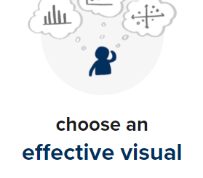
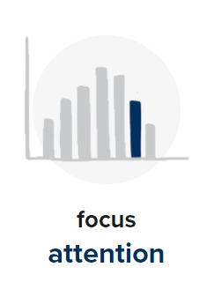
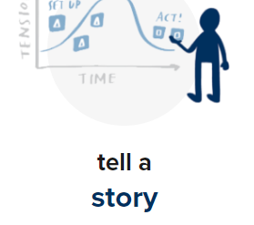
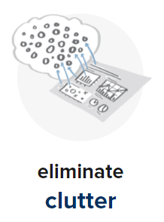
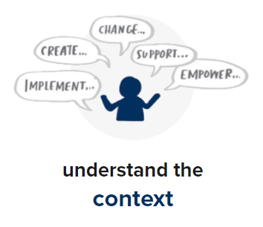
Data Storytelling
Image source - http://www.storytellingwithdata.com/
Notes:
Now let’s come to the title. What is your thought about Data Storytelling?
…
Why it is story instead of presentation, narration etc…
Anything if told like a Story – our human brain can understand very easily. In most of the public talks, usually stories make up atleast more than 50% of the content script. Or a talk with stories will give a great outreach. Even politicians do use, which some of you might remember. Because stories allow one to transform meaningful information better. The same can be applied while narrating insights as well.

Slide 6
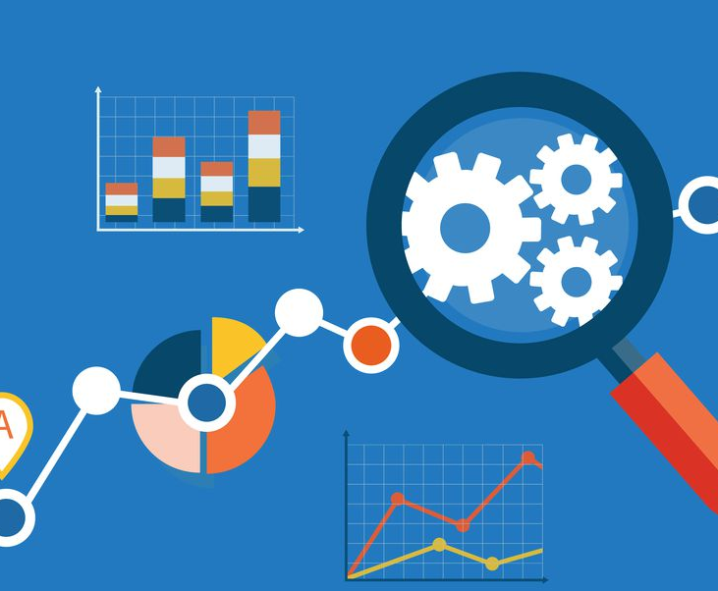
Importance of a dashboard
Discover patterns (HISTORY),
Metrics (CURRENT)
Spot trends (FUTURE).
Transferring DATA into INFORMATION / METRICS.

Slide 7
Importance of Storytelling
Transferring INFORMATION to understandable INSIGHTS.
How to convey your boss with data in Excel with thousands of rows?
Just convey it as a bar chart / pie chart instead of explaining numbers.
Meaning and purpose to the original data.
See the story that lives in your data.
Notes:
Takes our data visualization journey to next level.

Slide 8
Thumb rule of any BI tool
Connect and extract data from different apps/sources.
Analyze data and convert it as visuals.
Communicate and Share the insights.
Notes:
For Data Storytelling as well, it is going to be a BI tool that need to be used. So let us see the basic requirements that any BI tool will solve as a product.
It would enable connectivity in different business apps with ease along with security standards maintained during data transfers.
It would allow analyzing those data and allow creating effective visuals easily and should be able to narrate the insights on its own.
Communicating those insights securely is also equally important to the stake holders. As just an image or as an interactive dashboard.
The difference between different tools would be like, number of data source connections / number of charts / administrator features like user management / usability / cost factor / embedding and so on.

Slide 9
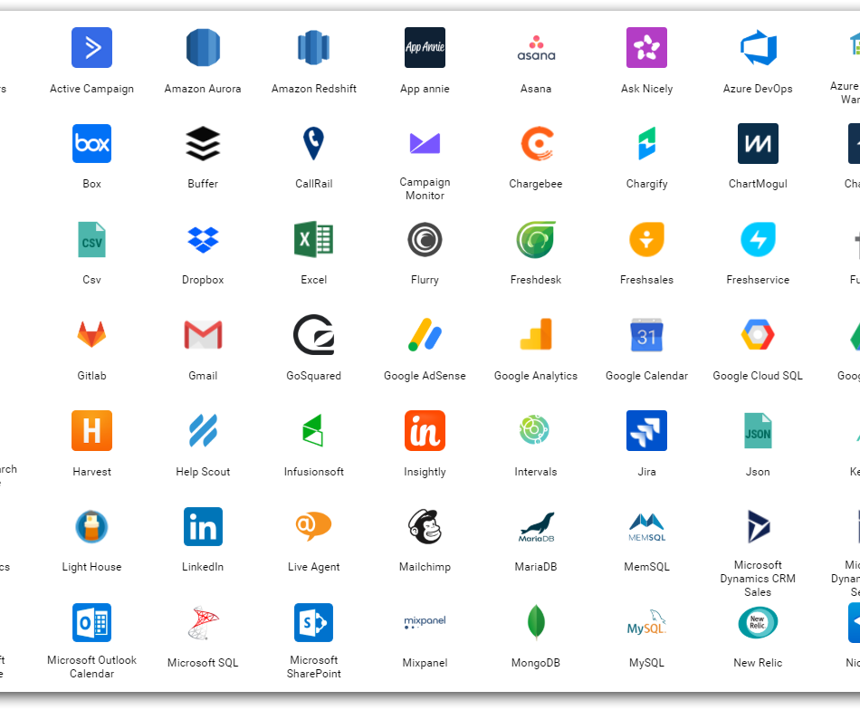
Data sources
“Having all the information in the world at our fingertips doesn’t make it easier to communicate; it makes it harder.” ― Cole Nussbaumer Knaflic
Web (REST APIs) – JIRA, CRM,…
Social Media
Logs
Databases
…
Notes:
On the process of getting insights, we get merged into an ocean of Data while analysing it.

Slide 10
Ad-hoc Reporting
“Any kind of report that you, the user, put together yourself, as and when you need it, rather than a pre-defined template”.
Examples:
Analysing “Bed Occupancy” when there is sudden hype in hospital admission,
Analysing hospital resources management like ICU, ventilators when there is more patients only for one specific scenario alone like COVID-19

Slide 11

Ad-hoc Reporting
How can I get started to be a storyteller or an Ad-hoc report creater?

Slide 12
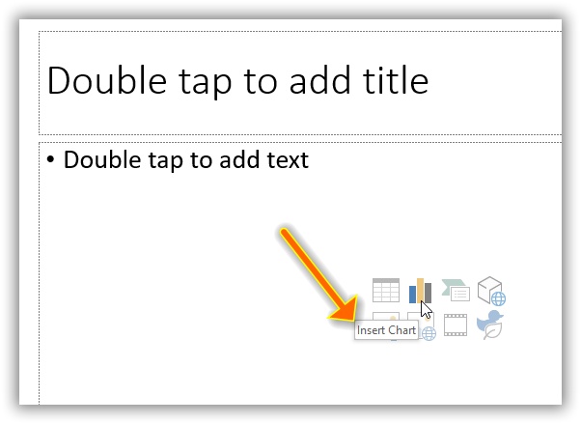
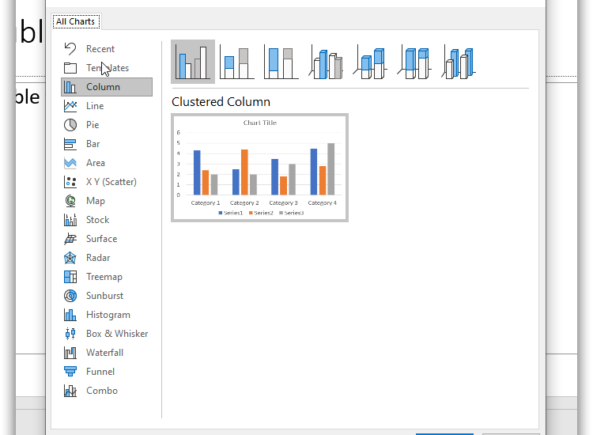
PowerPoint visuals
Notes:
Visuals in PowerPoint. A miniature of Excel and Power BI into PowerPoint itself.

Slide 13
PowerPoint Visuals

Slide 15
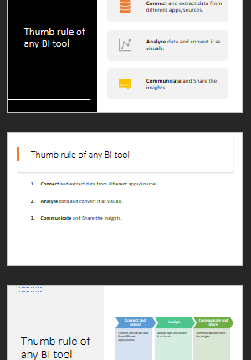
PowerPoint
Design Ideas
Notes:
Visuals in PowerPoint. A miniature of Excel and Power BI into PowerPoint itself.

Slide 16
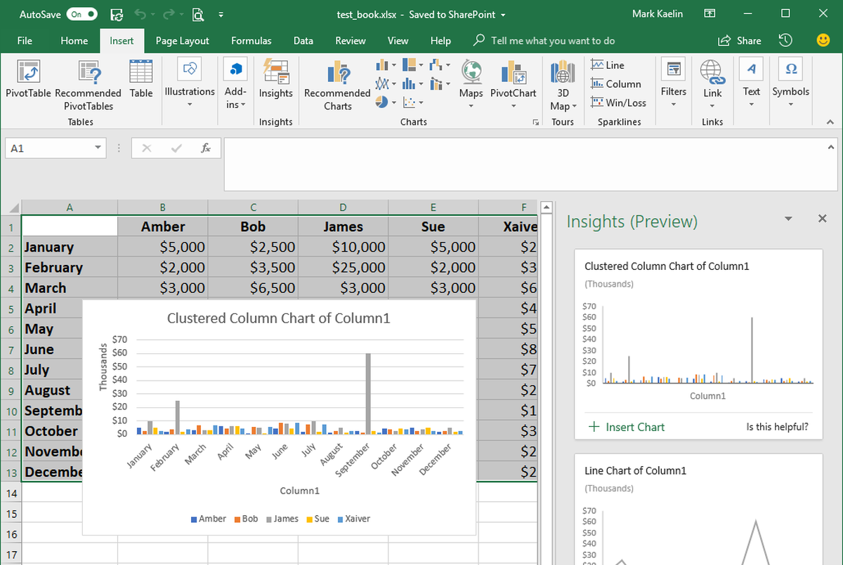
Excel
Notes:
Do anyone here knew or using “Ideas” in Excel already?
Evolving as Automatic Storyteller.
Quickest and easiest way of Learning data analysis and storytelling.
Works only with internet.
Demo
COVID-19 Data as Sheets, Dashboards, Story.
For Outliers – Show Energy Data as example.

Slide 17

Basic things to know for Storytelling

Slide 18
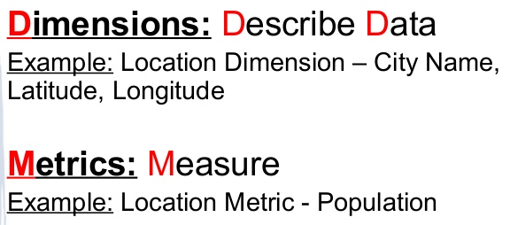
Dimensions vs Measures

Slide 19

Three things for effective visualization
Always audience in mind.
Clever in COLORS.
Use more Words.
June 2019
June 2020
Copyright © 2020 Syncfusion, Inc. All rights reserved.
Notes:
As mentioned in the first slide, effectively communicating the extracted insight to the target audience is important. These are 3 simple skills to improve the storytelling with data.
First and foremost is being specific about who your audience is. One should design everything keeping that audience in mind. Creating a chart for a communication purpose for our understanding is an easy task. If we step out of ourselves and think how do, we design for our audience will give effective results. Thinking is nothing but knowing ‘who are they’, ‘what do they care or expect’, ‘what keeps them up at night’.. Designing dashboards, keeping such motivation factors in mind will allow us to get their attention and can get our message across easily.
Next, coming to colors – It is not only about using pleasing colors in a dashboard. Think about where your audience to look and create a sparing contrast to achieve the attention.
Next, we should use more words in a dashboard. I mean it is words not sentences. Like axis labels, value labels, titles in a dashboard. Really these words will give more meaning quickly to the numbers and charts present in a dashboard.
https://visme.co/blog/dos-and-donts-chart-making/
https://infogram.com/blog/color-theory-dos-and-donts-for-data-visualization/

Slide 20
COVID-19 dashboard using Microsoft Power BI
Demo
Notes:
Open web power bi. Connect to csv file of latest COVID-19 data. Start designing and show the best practices with that. Finally show already created dashboard and tell the story - https://app.powerbi.com/groups/me/reports/279cdc82-8a49-487c-b015-21d6eb900de0/ReportSection0e72bac688f60e7252ea?noSignUpCheck=1
Show the curve flattened in China and not in other countries - https://coronavirus.jhu.edu/map.html

Slide 21
A Storytelling Dashboard…
Can communicate the insights, such that anyone can understand the context.
Next version of prepared dashboard that addresses one major question alone.
Personalized to one or a set of target audience for whom the mentioned insights are very essential.
Notes:
Now let us dive into “Data Storytelling”. <As per in the slide>

Slide 22
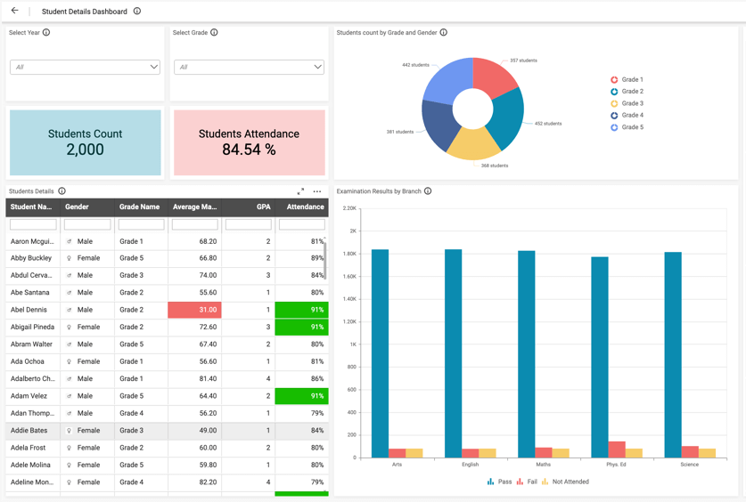
Understandable by everyone
One Student Performance Analysis Dashboard for entire college;
Principal/Secretary – All departments.
Department head – Specific department.
Class Tutors – Specific class.
So the dashboards should be filled-up with visuals understandable for all levels of people.
Notes:
One will look into a dashboard only if he feels he gets some insights out of it.

Slide 23
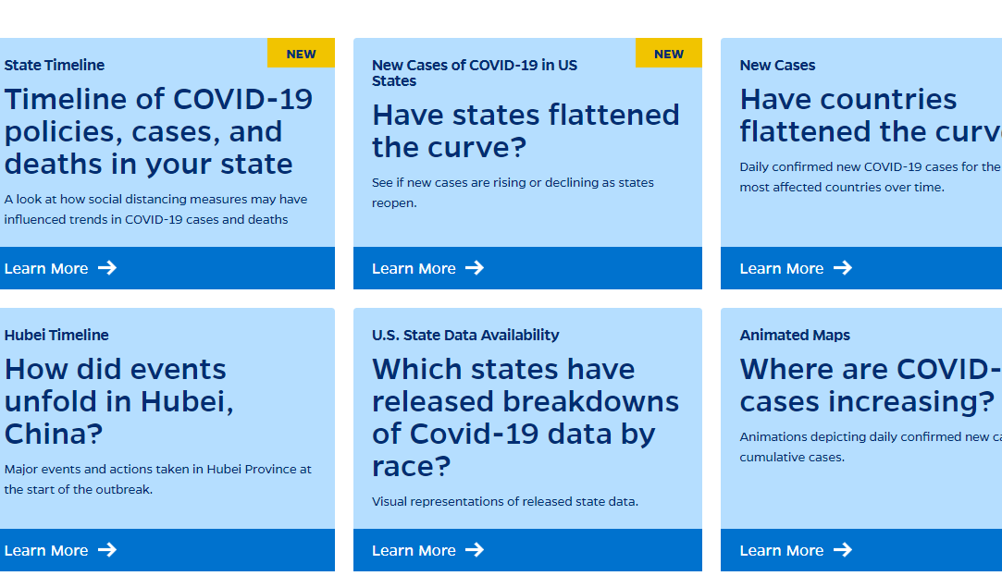
1 specific question
https://coronavirus.jhu.edu/data#charts

Slide 24
“Tension” to Resolution
Notes:
https://webinar.boldbi.com/bi/en-us/dashboards/c7878fd9-167c-478c-a251-56688fc7795d
While communicating data-driven findings, it is also important that you place the most important widget in right position which you want to communicate. We can call with a term like “Tension”. Again this tension doesn’t matter to you but to the audience. Just relating the same point which I mentioned in previous slide.

Slide 25
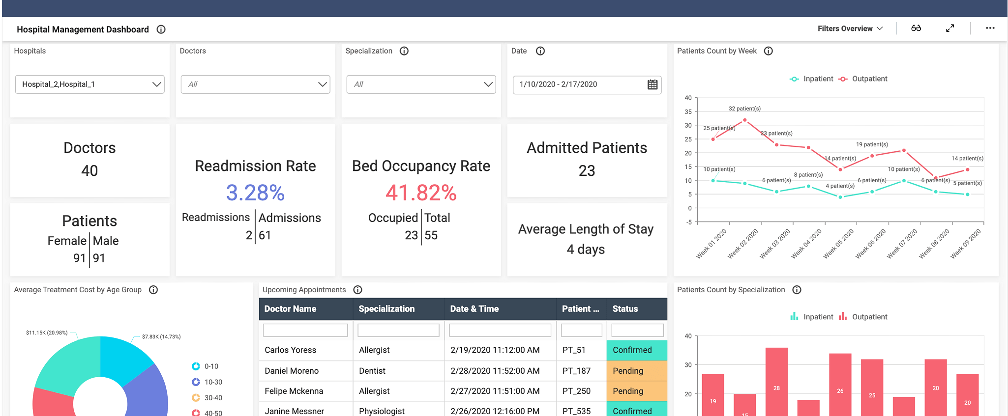
Positioning the KPIs
Notes:
https://demo.boldbi.com/bi/en-us/dashboards/dd055313-794e-4bc3-b53e-e949170b3331/
If you see in this example, the so-called Tension exists at the center “Bed Occupancy Rate” to track the bed availability. All other metrics are placed around this. Which helps the hospital dean to quickly understand the story in this data and take actionable decisions to increase the other resources as well like labour, nurses, doctors, cleaners not just bed.

Slide 26
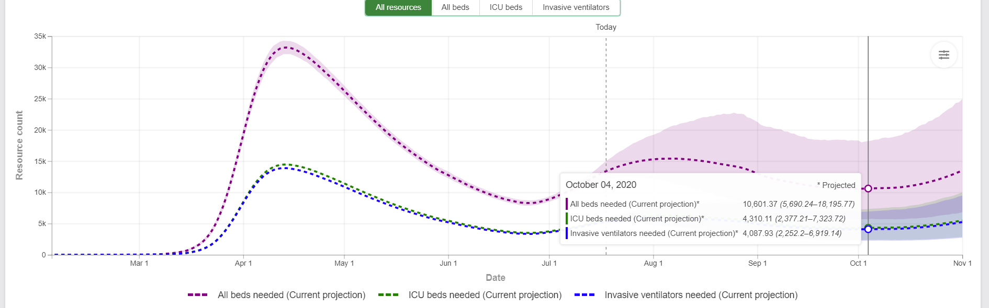
Hospital resources – IHME
https://covid19.healthdata.org/united-states-of-america

Slide 27
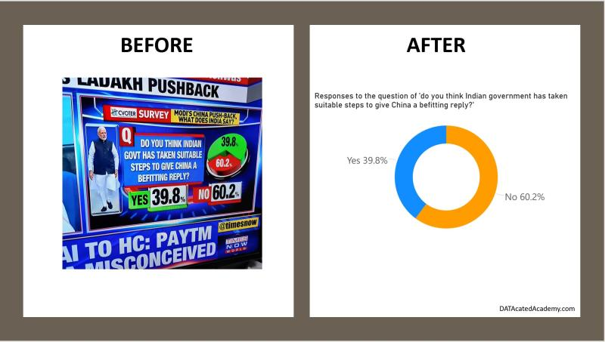
Not just a visual. Should be a right one.

Slide 28
Can you Answer?
Which one of the following is a Measure?
Sales Revenue
Sales Region
Sales Date
Notes:
Measures are numerical values that mathematical functions work on. Which one of the following is a Measure?

Slide 29
Can you Answer?
Which one of the following is a dimension?
Age of a person
Salary of a person
Notes:
By exercising Data Profiling

Slide 30
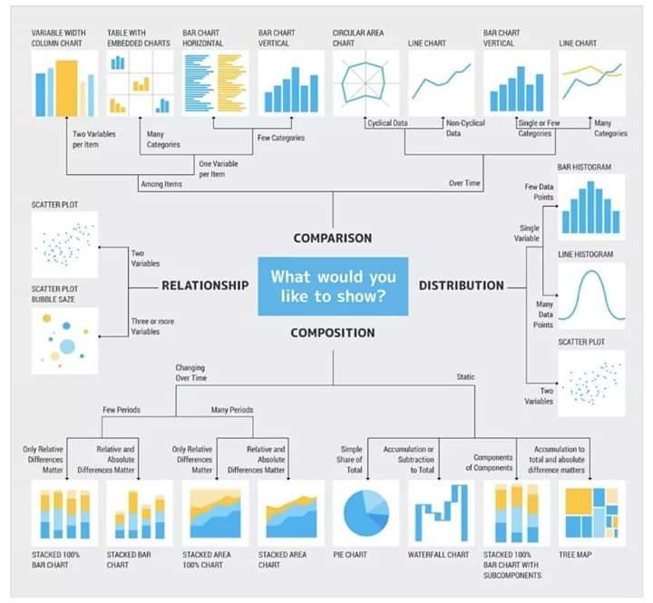
Notes:
This is like a rule book which most of us would be using while we get confused between choosing chart type.

Slide 31
Power BI (or) Tableau (or) Sisense (or) Qlik…….
A simple explanation would be,
Any of these tools are like a Kitchen in our home.
My mom is pretty familiar with the Kitchen in her home.
If she comes to my home, she doesn’t wait for anyone to tell about Kitchen.
She will adopt just like that knowing where the Gas Stove will be, The dishwashing space, Spices, Utensils etc. and start cooking!
Similarly if you are well deep in one BI tool, then automatically your mind will start capturing where is the formatting properties reside, where to add new data source, how to publish and share it and so on.

Slide 32
Power BI – How to get started?
Just Hotmail not enough.
To be a dashboard creator, you need Microsoft 365 subscription.
60-day free trial
https://docs.microsoft.com/en-us/power-bi/fundamentals/service-self-service-signup-for-power-bi
Notes:
Check in VM and show in VM

Slide 33
Power BI – Who can start to use?
Student -> want to enter into IT industry by learning a new technology?
Non-IT, you want to enhace your career in IT to upscale?
Doing a business, and you want to improve it by finding the hidden details of your data?
Of course if you are not falling under the list above, you can still learn Power BI.
Notes:
Points from this thread - https://www.linkedin.com/posts/vijaypravin_powerbi-datavisualisation-dataanalytics-activity-6688387504913043456-317r/

Slide 34
Different forms Data visualization emerge as Storytelling

Slide 35
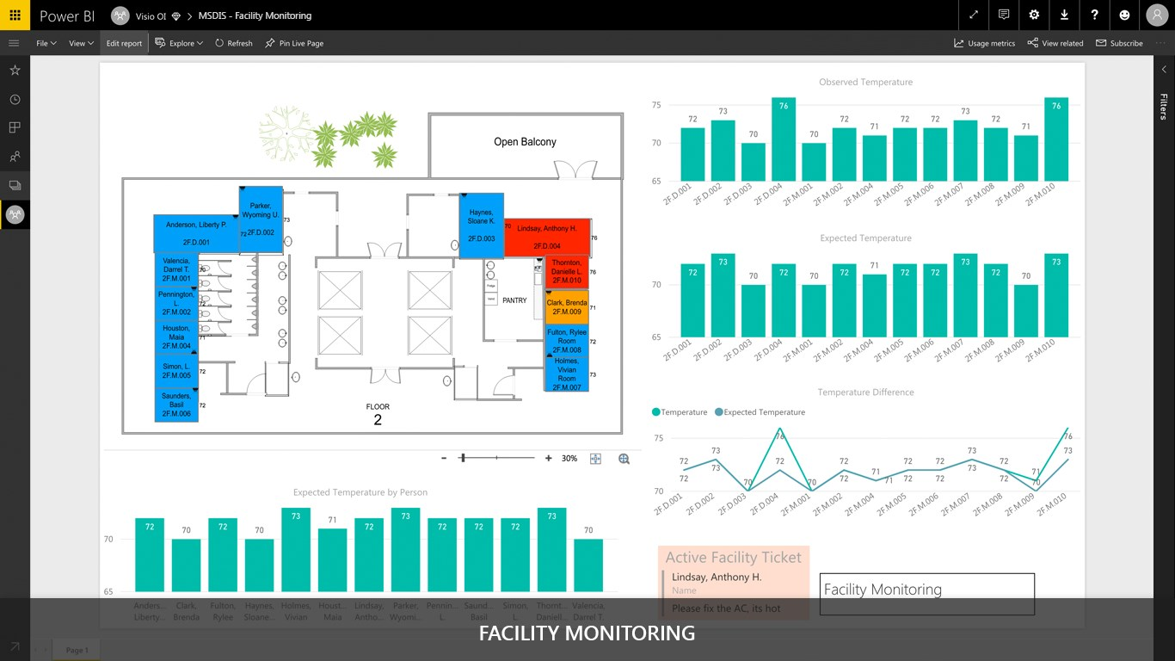
Microsoft Visio Visual
Notes:
https://appsource.microsoft.com/en-cy/product/power-bi-visuals/WA104381132?tab=Overview

Slide 36
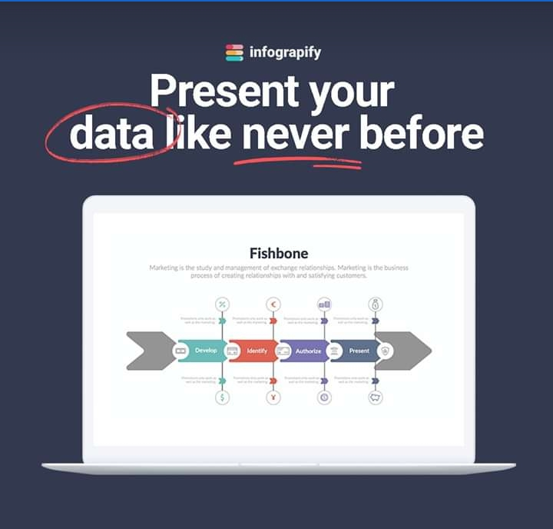
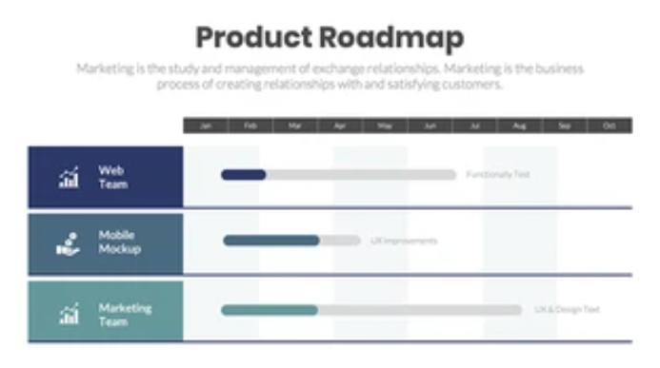
Infographics
Notes:
https://infograpify.com/products/product-roadmap?_pos=3&_sid=76f634c9c&_ss=r

Slide 37
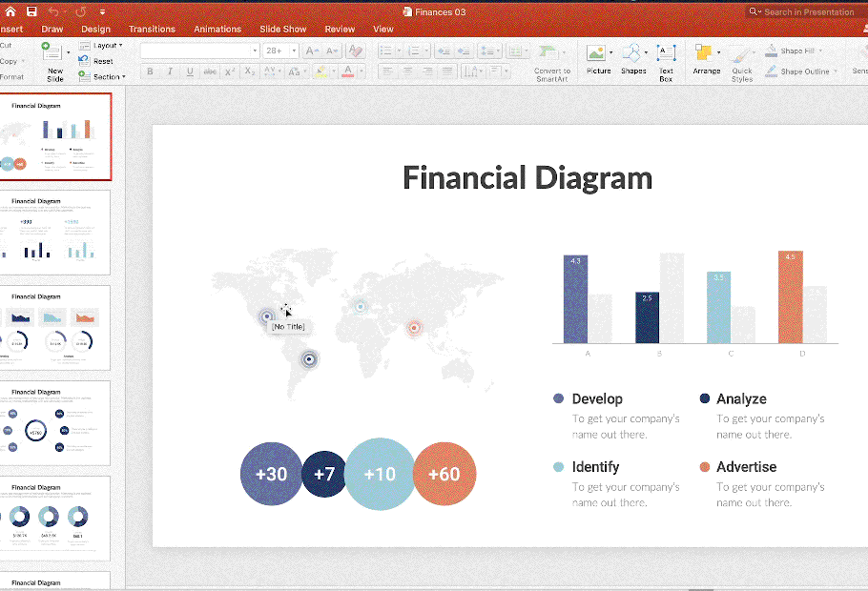

Slide 38
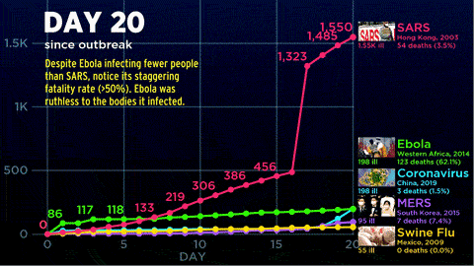
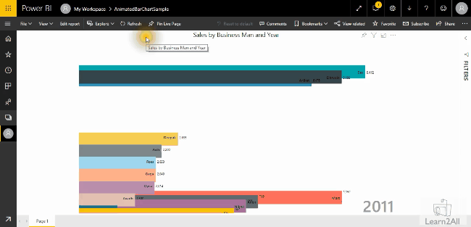
Animated visuals

Slide 39
Can you Answer?
What is the new feature in Excel that does automatic data visualization?
Notes:
Ideas

Slide 40
Can you Answer?
A chart that explains daily new cases by each day comes under,
Comparison
Composition
Relationship
Notes:
Comparision

Slide 41
Recap
Essential soft skill – Communication
Visualization
Any BI Tools’ – Basic functionalities
Ad-hoc reporting – how to start as a non-data guy
3 tips for best visualization, data storytelling with examples
COVID-19 cases demo in Power BI
Other forms of visualization using Microsoft tools
Notes:
Almost we are nearing the end of session;
If you incorporate the seed to be a storyteller then you can fit this everywhere in your work. Thought process itself will get changed.

Slide 42
Notes:
Now let me play this video - https://www.linkedin.com/posts/dinesh-kumar-prabakaran-b95a6656_leaders-weekend-friday-activity-6678894065909686272-mlHS/

Slide 43

Thank you! Questions ??
Notes:
Did you see guys? How powerful the visualization is? Mind understands and gives priority about what it sees first before what it can hear by words.

